Slide 1

Lesson: 6.04 Dictionaries and Loops
Microsoft Philanthropies TEALS Program – Introduction to Computer Science – Semester 2

Slide 2
Dictionaries and Loops
After this lesson, you will be able to...
Use loops to traverse through key/value pairs in a dictionary

Slide 3
Today’s Plan
Do Now
Lesson
Lab
Debrief
Notes:
Links updated 12/29/19
5 Minutes - Do Now: https://tealsk12.gitbook.io/intro-cs-2/unit6/lesson-3/do_now
10 Minutes – Lesson: https://tealsk12.gitbook.io/intro-cs-2/unit6/lesson-3
35 Minutes – Lab: https://tealsk12.gitbook.io/intro-cs-2/unit6/lesson-3/lab
5 Minutes - Debrief

Slide 4
6.04 – Do Now
 | Type the following:
1 | my_dictionary = {
2 | 'a': 1,
3 | 'b': 2,
4 | 'c’: 3,
5 | 'd': 4,
6 | 'e': 5
7 | }
8 | print(my_dictionary.keys()
In your notebook:
Write down what keys() does.
What type does keys() return?
Write down how you might use a for loop to go through and print the values of my_dictionary.
Notes:
Ask for a small number of students to write their solution on the board.
Discuss that it is possible to do just for key in my_dictionary:, but behind the scenes this is similar to calling the .keys() function.
Discuss that the order of the list is not exactly what was expected.
Unlike lists, dictionaries have no guaranteed order.

Slide 5
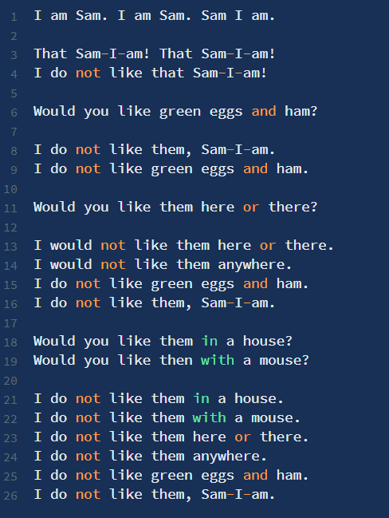
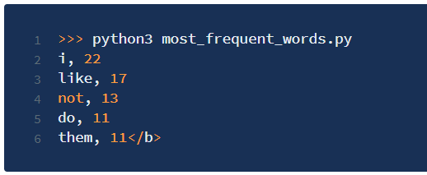
Lab 6.04
In this lab we will use our word-counting code from Lab 6.02 to create a program that determines the top 5 most commonly used words in a passage of text.
After processing the passage, it prints the top 5 words and the number of times each occurs.
You can see an example using the text from Dr. Susses’ “Green Eggs and Ham”

Slide 6
Lab – 6.04
In this lab we will use our word-counting code from Lab 6.02 to create a program that determines the top 5 most commonly used words in a passage of text.
After processing the passage, it prints the top 5 words and the number of times each occurs.
You can see an example using the text from Dr. Susses’ “Green Eggs and Ham”

Slide 7
Lab – 6.04 Sample

Slide 8
Lab – 6.04 Strategy
1. Repackage some of your code from Lab 6.02 to make two functions:
Text_to_word_list(), that takes a single passage of text and splits into a list of words
Count_frequencies(), that takes in a list of words and returns a dictionary of word frequencies
Write a new function, find_max_valued_key(), that takes a dictionary as an argument, and returns the key that is associated with the largest value in that dictionary. Internally, this function loops through the dictionary while keeping track of the largest value it's seen so far and the key that goes along with that value.
Run find_max_valued_key() once on the dictionary of word counts, print out the key/value of word it returns.
Remove that key from the dictionary.
Repeat steps 3-4 four more times: Call find_max_valued_key(), print out the key/value pair, and remove the key.
If there is a tie within find_max_valued_key(), choose among the tied items however you like and return just one of them.

Slide 9

Dictionaries and Loops – Debrief
Notes:
Take a moment to discuss any common areas of confusion or challenge that came up during the lab.
Talk about how in works for dictionaries for the bonus.

